Slide 1

JSON Editor 2
https://codesandbox.io/s/wizardly-leavitt-o3vl4

Slide 2
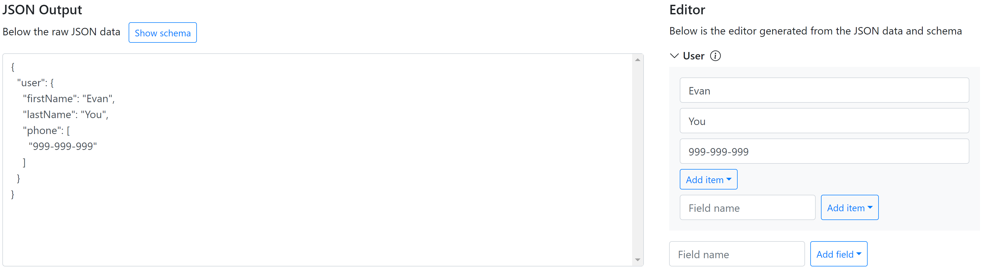

Data

Slide 3
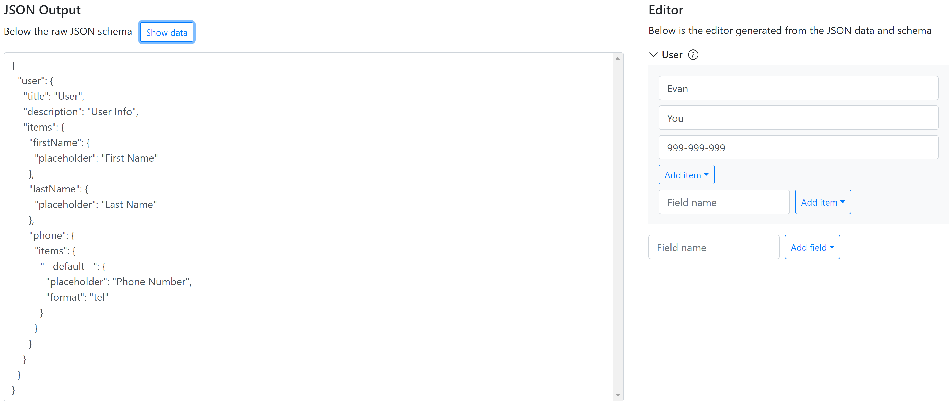

Schema

Slide 4
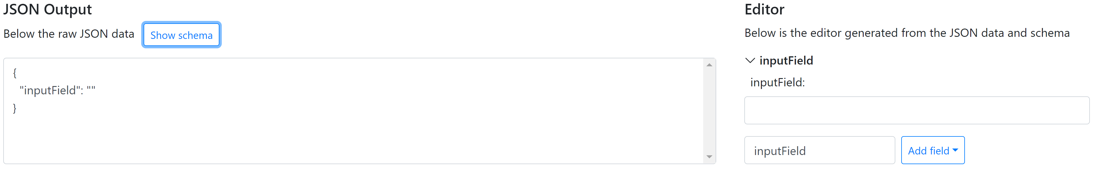

Input Field Data

Slide 5
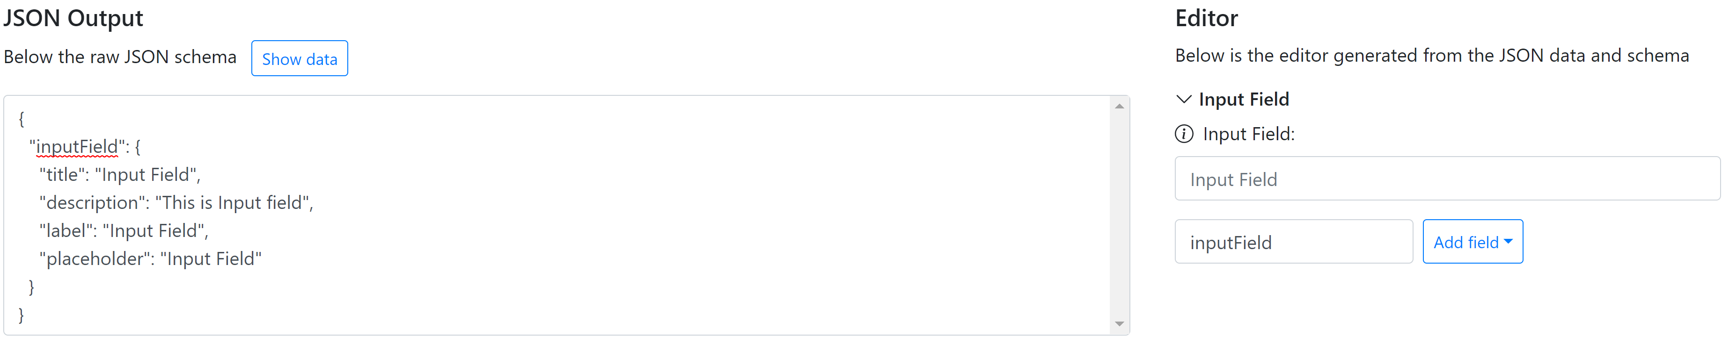

Input Field Schema

Slide 6
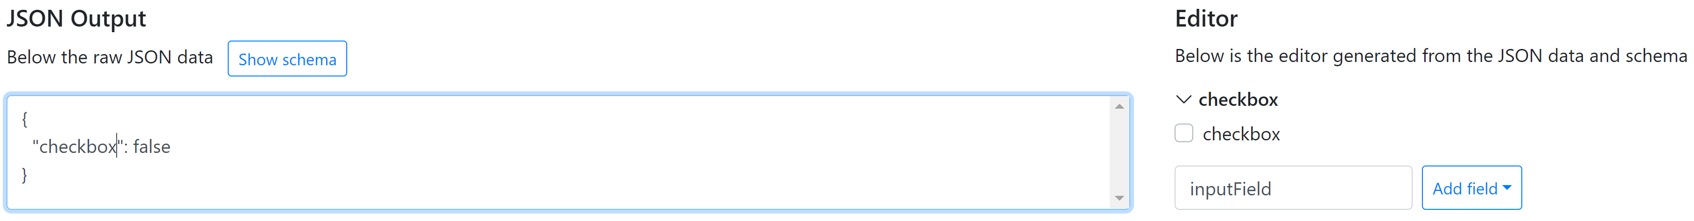
Checkbox Field Data

Slide 7
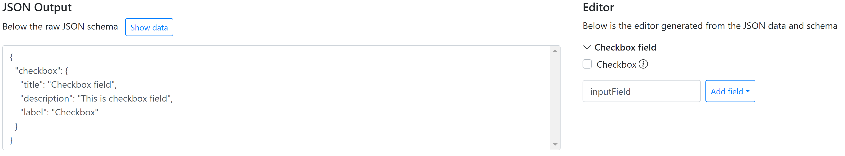

Checkbox Field Schema

